Slide 1



Astro
In this presentation we will:
Meet Astro, an enterprise data gathering infrastructure. Astro provides whitelisted IPs with 100+ country coverage and 99.9% uptime.
Explain how AI tools assist in scraping.
Introduce the AI-Scraper cycle — a new direction redefining automation in 2025 and beyond.
Real-time statistics on latency, trust scores, geographic location and more for residential, mobile and datacenter proxies.
Talk about ethical proxies as a foundation for the cycle.
Show how Astro transforms data gathering.
1

Slide 2






Generative AI in scraping
AI is here to stay. According to McKinsey, the number of companies that regularly use GenAI increased from 33% to 71% (McKinsey & Company 2024)
How GenAI assists in data extraction:
It allows to:
Code generation with AI tools
Adapt to shifts in websites' changes, reducing the need for manual inputs.
Creating custom scrapers from an HTML sample.
Cleaned HTML extraction with LLMs
Process natural language instead of complex HTML scripts, reducing the technical barrier.
Parsing full pre-processed HTML code while filtering out unnecessary sections.
Analyze contextual information and semantics to interpret unstructured content.
Computer vision (CV) techniques
Analyzing screenshots of the website instead of HTML, and interpreting them with LLMs.
2

Slide 3
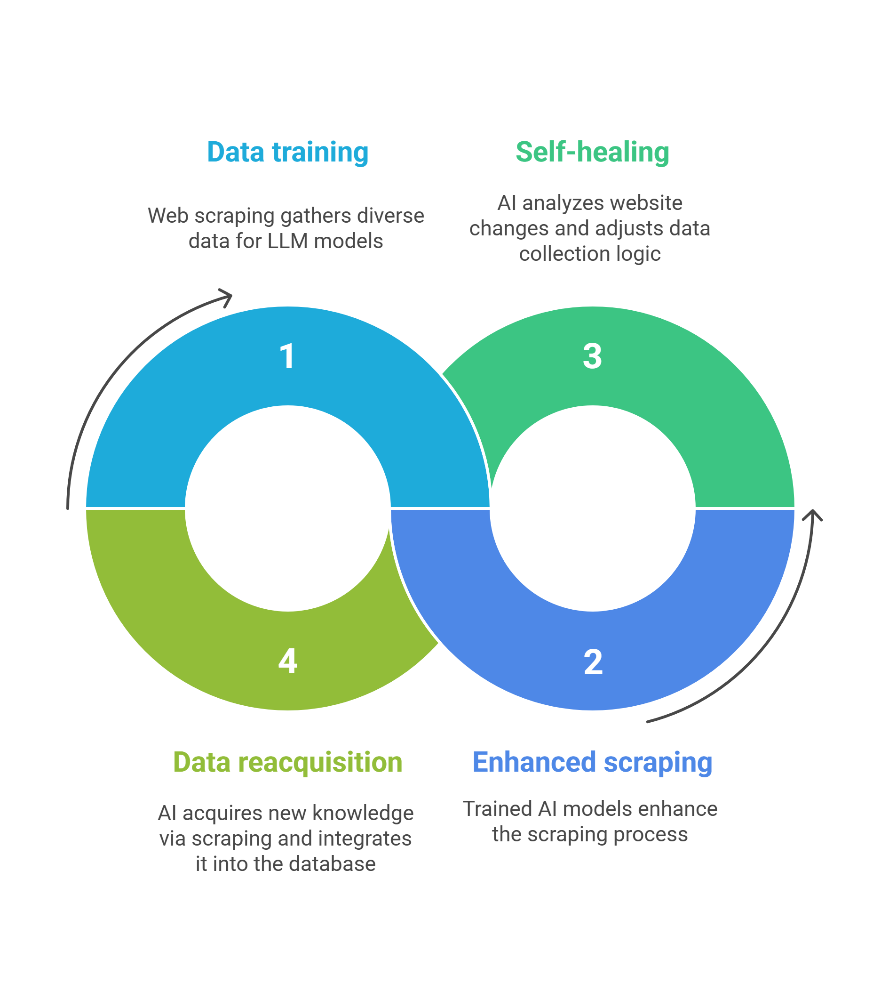
The AI-Scraper cycle
By 2025, technology has advanced to the point where AI pipelines can be integrated directly into scraping workflows.
This symbiotic relationship is called the “AI-Scraper cycle”. It's a self-reinforced feedback mechanism that automatically adjusts XPath expressions, CSS selectors, and other parameters. It predicts future changes by analyzing historical patterns.
LLMs do not eliminate the need for proxies. Proxies remain fundamental for access, regional targeting, and maintaining compliance within AI-driven scraping systems.
3

Slide 4
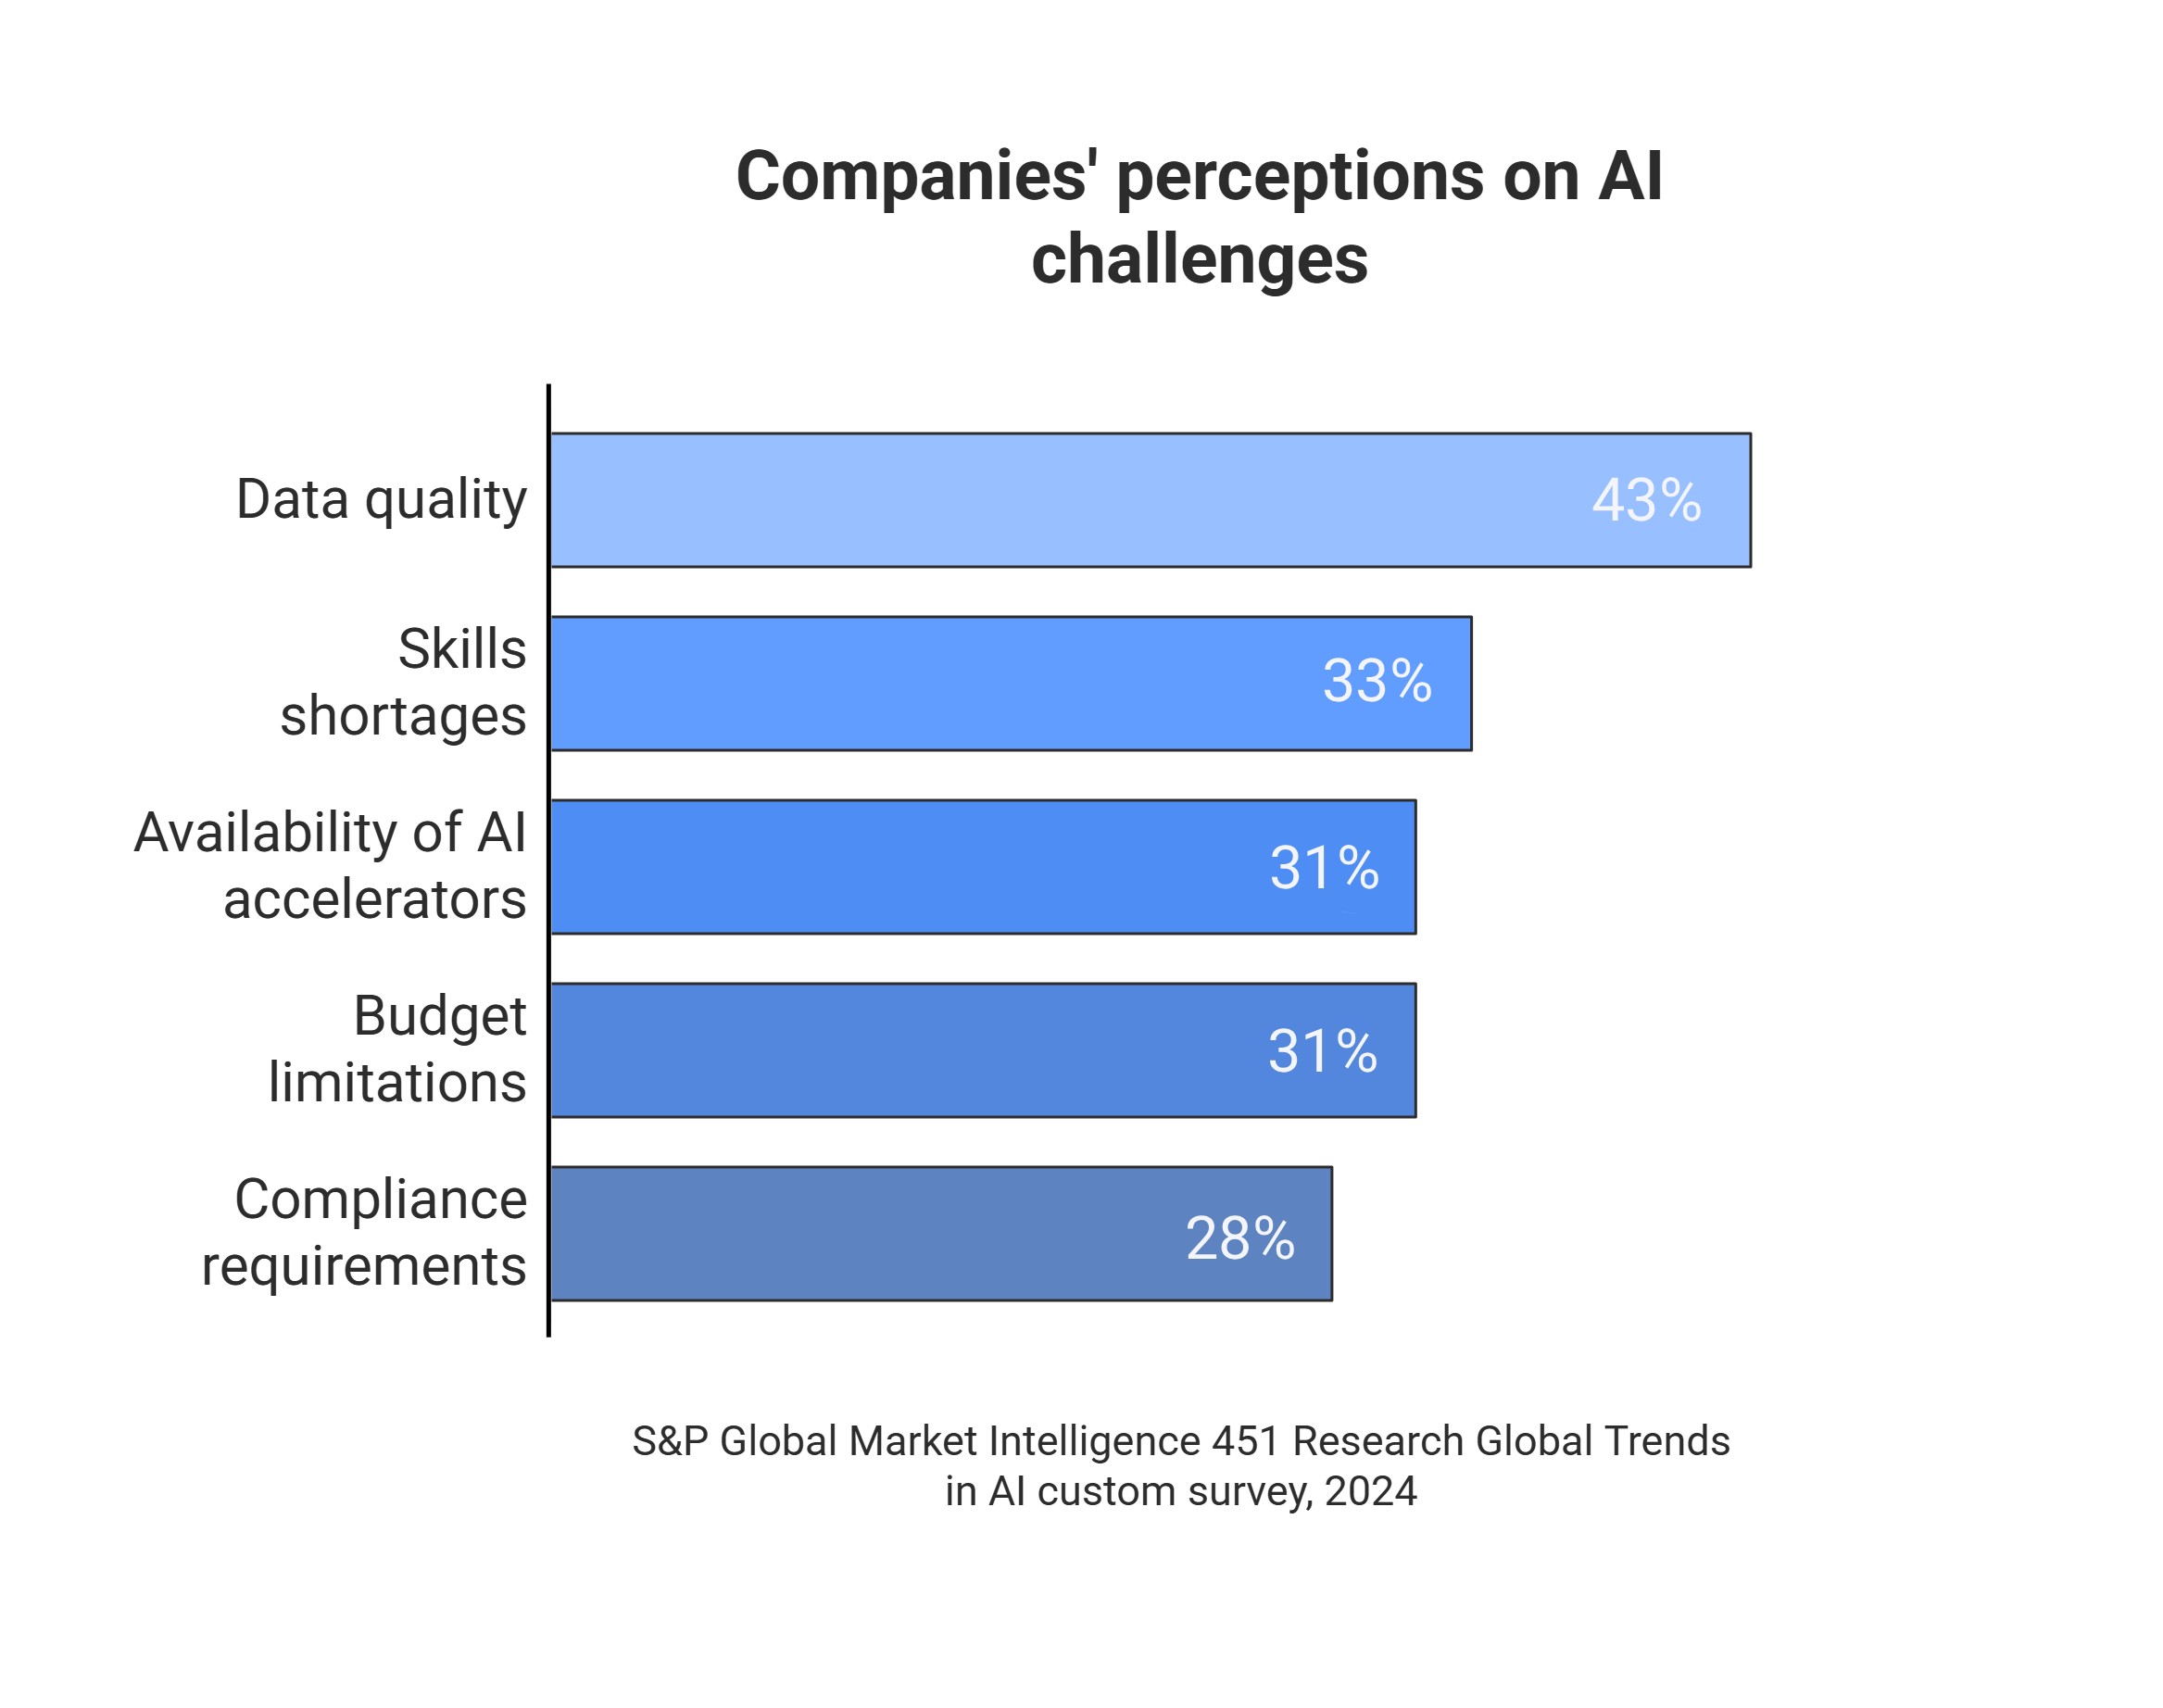



The ethical foundation
The AI-Scraper cycle works as intended only when it's built on a foundation of ethical data gathering, and that's not just a buzzword.
Resource longevity
Whitelisted IPs are gathered with user consent. A relationship of trust between users and proxy services promotes longevity of residential and mobile proxies used in AI-assisted scraping.
Data accuracy
Compliant infrastructures ensure uninterrupted data streams. As LLMs ingest both high- and low-quality materials over time, data quality has become one of the leading challenges for businesses.
Regulatory compliance
Adherence to ethical standards demonstrates due diligence and simplifies regulatory compliance for business practices.
4

Slide 5

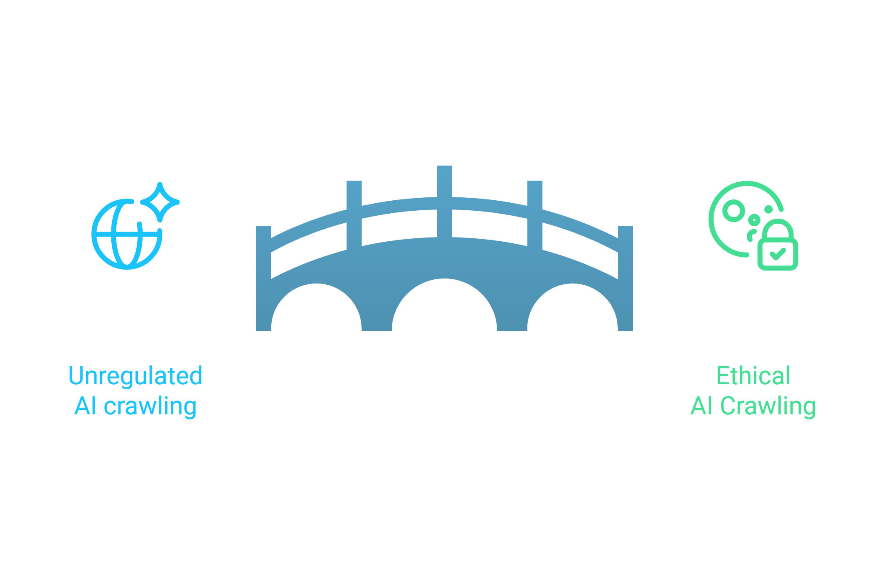
AI ethics on the rise
To further demonstrate the importance of AI ethics, we present a case of an emerging tool Cloudflare Pay Per Crawl. In 2026, AI systems may need to obtain explicit permission before accessing websites.
“We can now limit access to our content to those AI partners willing to engage in fair arrangements,” — Neil Vogel, CEO of Dotdash Meredith.
HTTP message signatures and request mTLS could make it possible for only greenlighted requests to access content.
Building a bridge to ethical AI practices with Astro will safeguard reputation in the long run.

Slide 6







Astro: ethical proxies in action
Astro ensures compliance, transparency, and responsible proxy sourcing.
We continue to improve our policies with artificial intelligence in mind.
Ethical: Consent-based, KYC/AML-vetted, whitelisted IPs.
Precise: City/ISP pinning, engine-aware runs.
Audit-ready: Evidence store with screenshots/HTML/headers.
How we keep your data safe:
Individual Ports
Dedicated Access
Whitelist Functionality
Exclusive, non-shared proxy ports give every user their own dedicated IP.
Unique login credentials per port safeguard usage and ensure only authorized access.
Allows only trusted external IPs, further strengthening privacy.
5

Slide 7






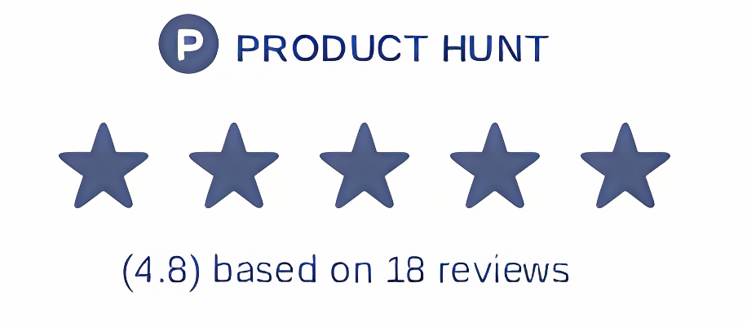
Get started with Astro
Join Astro and transform your data gathering experience with ethical, high-performance
proxies from Germany, France, Japan, Turkey, Russia, and other countries.
Visit astroproxy.com
Contact us and request a free trial
Buy residential, mobile, or datacenter proxies
Or scan to visit Astro
6

