Slide 1



Enterprise Data Gathering Infrastructure Presentation Slide Set

Slide 2
Table of Contents
3
4
5
Introduction: Empowering Innovation with Public Data
Astro Services: for the Best Data Collection Experience
IP Addresses: Quality and Reliability
Pricing and Value: Competitive Advantage
Why Choose Astro: Key Advantages
6
7
8
Quality and Reliability: Ensuring Success
Astro: Accelerating AI with Data Aggregation
Astro: Your AI-Ready Data Source
Fueling AI Development
Data Aggregation Advantages
The Astro Difference: Trusted and Secure
Astro Proxy: A Powerful Tool for Web Scraping, Data Collection, and Online Security
Understanding Astro Proxy Ports
9
10
11
Ensuring Reliability and Uptime
Features of Astro Ports
Security and Privacy
Sustainability and Encryption-Driven Privacy
Key Steps to Get Started
Astro's Dynamic Proxy IP Rotation: Boosting Access & Data Quality
Customizing IP Rotation
Maintaining Access with City-Level Targeting
12
13
14
IP Rotation Modes: Choosing the Right Fit
Seamless Integration with Astro
Key Considerations for IP Rotation
Astro Operates Only IPs with High Trust Score
Geo-Targeted Proxies for Web Data Collection
Enterprise-Level Proxy Infrastructure
Optimizing Your Selection & Configuration
Leveraging Proxies for Social Media Management
15
16
17
Essential Steps for Successful Social Media Campaigns
Navigating Data Access Restrictions
Astro's Expertise in Open Web Data Extraction
Astro: Safe Data Gathering
KYC and AML Compliance
Astro's Support Team: Your Reliable Ally
Building Trust: Your Success is Our Success
18
19
Availability: Your Convenience is Our Priority
Focus: Proxy Settings and Performance
Dedicated Support: Personalized Assistance
Join Astro’s Community

Slide 3

Empowering Innovation with Public Data!
Dear colleagues,
At Astro, we believe in the transformative potential of data to drive innovation through AML and KYC-compliant proxy infrastructures. We consider our mission in delivering secure and ethical access to open web data through dynamic residential, mobile, and datacenter geo targeted proxies. From studying markets and training AI-based models to protecting brands and performing SEO tasks, our KYC-compliant methods of extracting open web data are reshaping industries.
As an ethical proxy ecosystem with IPs gathered with users’ consent, Astro is proud to announce that we have surpassed the two million IP addresses' threshold by 2025. We provide customers with access to open internet data in 100+ countries worldwide. This information not only fuels innovation but also meets the up-to-date standards of ethics. We offer dynamic proxies with a free proxy test and 100% compatibility with AI and ML to make data collection simple as never before.
Our mission is clear—keep public data accessible to empower businesses, researchers, and organizations worldwide in strict compliance with KYC/AML code and AI/ML approach. Thousands of companies that are choosing our solutions are the proof of how data creates a better, safer, and more connected world.
Thank you for being part of our community and for buying Astro's residential, mobile, and datacenter proxies to turn data into impact. Together, we're building a future where information drives progress.
Sincerely, Team Astro

Slide 4
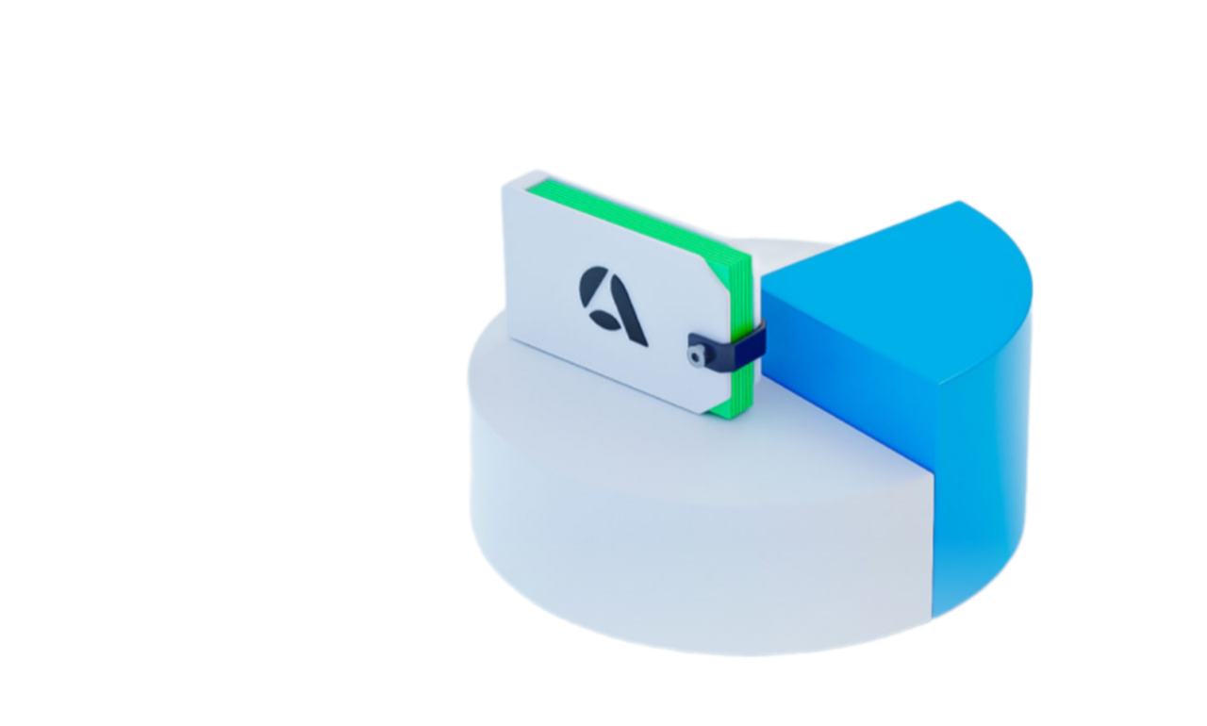
Astro Services: for the Best Data Collection Experience
Welcome to Astro, your reliable partner for web data collection and analysis. We provide a wide proxy network for businesses and individuals looking to access and leverage data from the internet.
We offer:
Residential Proxies
Residential proxies are sourced from real home internet service providers (ISPs) in over 100 countries. These proxies offer superior geo-targeting capabilities and are excellent for bypassing security measures and collecting data from geographically sensitive websites.
Mobile Proxies
Mobile proxies are sourced from mobile carriers, offering the same geo-targeting advantages as residential proxies. These proxies are ideal for simulating mobile device behavior and collecting data from websites that are specifically optimized for mobile use.
Datacenter Proxies
Datacenter proxies offer fast and reliable connections, ideal for general web scraping and data collection tasks. These proxies are located in datacenters around the world, providing access to a vast pool of IP addresses.
IP Addresses: Quality and Reliability
1
Dedicated Ports and Individual Proxies
Rotating IPs for Enhanced Privacy
3
2
Geo-Targeted Proxies
Each datacenter, residential, or mobile proxy you purchase comes with a dedicated port, ensuring private and secure access. Every proxy has its own external IP address, and a single IP address corresponds to a single port. This eliminates shared proxy ports and potential security risks.
All our proxies are rotating, meaning their external IP addresses change regularly. This feature is ideal for most web scraping tasks and helps to avoid detection by websites. Rotating IPs are also beneficial for maintaining privacy and evading IP-based restrictions.
We provide access to geo-targeted proxies, allowing you to specify the desired geolocation for your web scraping tasks. You can choose a specific country, city, or even internet service provider (ISP) to ensure that your requests are originating from the right location.

Slide 5




Pricing and Value: Competitive Advantage
Competitive Pricing
Astro offers competitive pricing plans, providing you with access to our entire proxy network at affordable rates. We offer instant access without hidden fees or additional charges, ensuring maximum value for your investment.
Ethical Sourcing
All our proxies are sourced ethically, ensuring compliance with KYC and AML policies. We prioritize user privacy and data security, providing you with peace of mind knowing that you're using trustworthy proxies.
Fast and Reliable
Our proxies are fast and reliable, so you can get consistent access to data. We maintain a robust infrastructure to guarantee stable connections and minimize downtime, ensuring that your web scraping tasks run smoothly.
Why Choose Astro: Key Advantages
Unlimited Duration
1
Once purchased, your proxies remains active for an unlimited period of time, based on your chosen pricing plan. This allows you to access and leverage our whitelisted IPs for as long as you need.
Dynamic IP Management
2
Our system automatically provides a new IP address from the same geolocation if your current IP goes offline. This ensures uninterrupted access to data and seamless operation of your web scraping tasks.
Comprehensive Proxy Network
3
Astro offers a wide range of proxy types, so you can have a solution for every data collection need. We cater to various open web data management tasks and data analysis requirements.
Dedicated Support
4
Our dedicated support team is available to assist you with any questions or concerns you may have. We strive to provide excellent customer service and technical support to ensure a smooth and satisfying experience.

Slide 6

Quality and Reliability: Ensuring Success
Ethical Sourcing
We prioritize ethical sourcing of IP addresses, ensuring compliance with all relevant regulations and policies. We offer only credible and whitelisted proxies that are free from any blacklisting issues.
Dedicated and Private
Astro operates as a trusted proxy website with private proxy ports. This ensures that each proxy you purchase is dedicated to you and not shared with other users, guaranteeing optimal performance and security.
Advanced Features
Our proxies offer advanced features such as rotating IPs, geo-targeting, and ASN identification. These features enhance your web scraping capabilities and provide you with a competitive edge.
Astro: Accelerating AI with Data Aggregation
Astro is a powerful data aggregation platform that helps businesses accelerate AI and machine learning initiatives by providing them with access to high-quality datasets
Astro: Your AI-Ready Data Source
Data Collection
Data Integration
Our data collection capabilities allow businesses to retrieve vast amounts of diverse data from various sources, including text, images, media, and metadata. It supports structured and unstructured data types, ensuring comprehensive data capture.
Our infrastructure seamlessly integrates with your existing data storage solutions, making it easy to manage your collected data. You can easily import the data into your preferred platform for analysis and model training.

Slide 7

Fueling AI Development
Model Training
Deep Learning Enhancement
Astro's high-quality datasets accelerate AI model training, allowing you to build more robust and accurate models in less time. By providing a rich and diverse dataset, Astro helps you improve model performance and achieve better results.
Astro enhances deep learning algorithms by providing massive amounts of training data, crucial for the development of advanced AI models. With access to diverse and relevant datasets, you can push the boundaries of deep learning and unlock new possibilities.
Improved Machine Learning Outcomes
Overall, Astro improves machine learning outcomes by providing a foundation of high-quality data. This translates into better predictions, more accurate insights, and ultimately, more successful AI projects.
Data Aggregation Advantages
1
Global Coverage
Astro's extensive network of global residential, mobile, and datacenter IPs ensures comprehensive data collection from around the world, even those with strict multilayered limitations.
2
Geo-Targeted Precision
Astro's geo-targeted capabilities enable businesses to collect data from specific geographic locations, great for targeted insights and analysis.
3
Diverse Data Types
With Astro’s IPs you can collect a wide variety of data types, including textual, graphical, media, and metadata, providing a comprehensive dataset for complex AI projects.

Slide 8



The Astro Difference: Trusted and Secure
100+
99.9%
Countries
Uptime
Astro Proxy: A Powerful Tool for Web Scraping, Data Collection, and Online Security
Understanding
Astro Proxy Ports
Proxy Pool Basics
Astro's proxy pool is a massive collection of IPs from various sources, including home ISPs, mobile carriers, and data centers. This pool is constantly growing, currently boasting over 100,000 IPs daily and 2,000,000 unique IPs monthly. You can buy residential, mobile, or datacenter proxies from over 100 countries to access reliable geo-targeted proxies ranked by country, city, and ASN.
Port-Based Proxy Access
Each proxy server operates on a unique port (IP:PORT). This port represents a dynamic proxy with a rotating external IP address connecting to Astro's servers. You can set up IP rotation based on timers, new connections, requests, or force it manually. You can also customize the protocol for each port, choosing between HTTP(S) and SOCKS5.

Slide 9

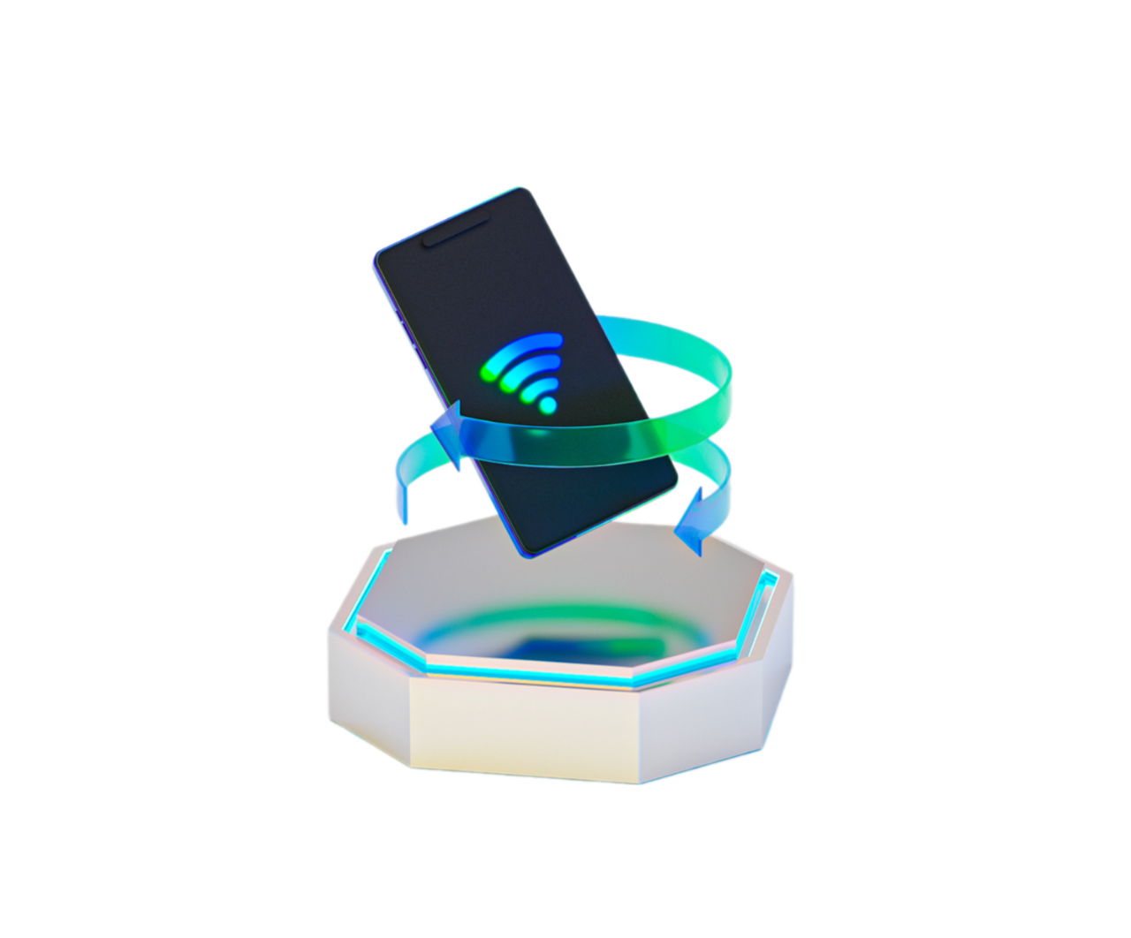



Ensuring Reliability and Uptime
99.9% Uptime Guarantee
Rapid Issue Resolution
Flexibility and Control
Astro offers dynamic proxies built on AI-enhanced algorithms, ensuring industry-leading uptime of 99.9%. This ensures that your proxies are consistently available and operational.
Astro's dedicated technical team promptly addresses any technical issues that may arise. We care that our proxies have minimal downtime and maintain high availability.
You can easily change the external IP address for any port every 30 seconds through the web interface or API. This provides you with maximum flexibility and control over your proxy setup.
Features of Astro Ports
1
High Concurrent Connections
2
Support for Multiple Protocols
Each port can handle up to 250 concurrent TCP connections, enabling you to manage multiple tasks and requests simultaneously.
Our proxy servers support both SOCKS5 and HTTP(S) protocols, allowing you to choose the most suitable option for your business or personal needs.
3
Customizable Proxy Groups
You can organize your geo-targeted proxies into custom lists for easy management. Combine different IPs, edit lists, rename ports, and export lists as .txt files with adjustable settings.
Security and Privacy
Individual Ports
Dedicated Access
Whitelist Functionality
Astro provides individual, non-shared proxy ports, ensuring that each user has exclusive access to their own IP address.
Each proxy port has a unique login and password, safeguarding your access and ensuring only authorized users can utilize the proxy.
You can restrict access to your proxy ports by configuring a whitelist of allowed external IPs, further enhancing security and privacy.

Slide 10



Sustainability and encryption-driven privacy
250 TCP Concurrent Connections per Port
1
Each port provides reduced latency and faster response times for enterprise-level scalability and enhanced data collection. Collect open data for teaching AI-based models or implementing machine learning frameworks.
Increased Compatibility and Load-balancing
2
Enable Tunnel mode to encrypt the connection by OpenVPN standards and get the settings for your devices (iOS, Android, Windows, macOS, etc.), and boost the authenticity of your digital fingerprints.
VPN Encryption Support
3
Combined with HTTP(S)/SOCKS5 support and 100% diverse apps' compatibility, Astro's geo targeted proxies minimizes the risks of connection drops.
Web protocols to pick from and a TLS encryption
IPv4 Proxies
IPv6 Proxies
Access high-protected social media sites, marketplaces, and more through ethically sourced IPv4 proxy servers located in 100+ countries.
Empower your data collection routine with IPsec encryption, straight routing, and checks of packets' integrity offered by the IPv6 proxy servers from Astro.
1
2
3
Default TLS Encryption
Manage accounts on socials, extract public data, test apps, and more in strict compliance with GDPR, HIPAA, CCPA regulations. Turn a TLS encryption on/off anytime to switch between higher privacy and faster ping.
Key Steps to Get Started
1
Sign Up for a Free Trial
Create an account on the official Astro website to explore all features of the AML and KYC-compliant rotating proxy servers at no charge.
Experience Full-Fledged Proxy Access
2
Get an instant account top-up and buy residential IPs, 4G/5G/LTE or datacenter proxies. Rotate external IP addresses, export settings to your software, check ping and pool size. Web dashboard has features like statistics, API, URL-based control.
Contact Support for a Free Proxy Trial
3
After signing in, follow the links in the pop-up window to get a free trial access from AI-based bot. Select between Facebook and Telegram. Requests are processed automatically 24/7.

Slide 11


Astro's Dynamic Proxy IP Rotation: Boosting Access & Data Quality
Why Rotate?
IP rotation is crucial for accessing websites securely and effectively. It helps prevent IP flagging, where websites block access due to excessive requests from a single IP.
How it Works
Astro dynamically changes your proxy's IP address based on your chosen settings, ensuring seamless access to target websites.
Customizing IP Rotation
1
By Timer
Set a fixed time interval for IP changes, ensuring regular updates. Ideal for consistent data collection.
2
By Link
Change IP addresses through a custom URL, providing granular control over rotation frequency.
3
By City
Rotate IPs within a specific city, targeting particular geographical locations for your data collection.
Maintaining Access with City-Level Targeting
City-Level Targeting
Astro's city-level targeting ensures accurate geo-location for your proxy connections. This enhances access success, especially for mobile proxies where ISP-level targeting is recommended.
Geo targeting increases sales and traffic driven to a website. Buying residential and mobile proxies is the best option for geo targeting goals. They make it possible to set a remote connection to the region with the target audience.
11

Slide 12



IP Rotation Modes: Choosing the Right Fit
Per-Request Mode
Dynamic Mode
Change IP for every request, ideal for specific data collection tasks that require high privacy. Consult Astro Support for recommendations.
IP changes are automated, providing a balance between security and efficiency. Use this for general web surfing and data collection.
Seamless Integration with Astro
Select your proxy type: residential, mobile, or datacenter.
Integrate our proxies into your third-party software or browser.
1
2
3
Set your IP rotation rule based on your chosen mode.
Accessing Astro's IP Rotation Tools
Control Link
Access your profile to manage your IP rotation settings and control your proxy connections.
API Key
Find your API key in the main menu under API settings. Use it to automate IP changes through your software.
API Integration
Utilize Astro's API functions for seamless integration with your software, including IP rotation functionality.
Key Considerations for IP Rotation
1
Security
Ensure that your proxy connections are secure and protected from unauthorized access.
2
Privacy
Protect your identity and maintain confidentiality while browsing and collecting data online.
3
Performance
Maintain optimal speed and efficiency during your web browsing and data collection activities.

Slide 13
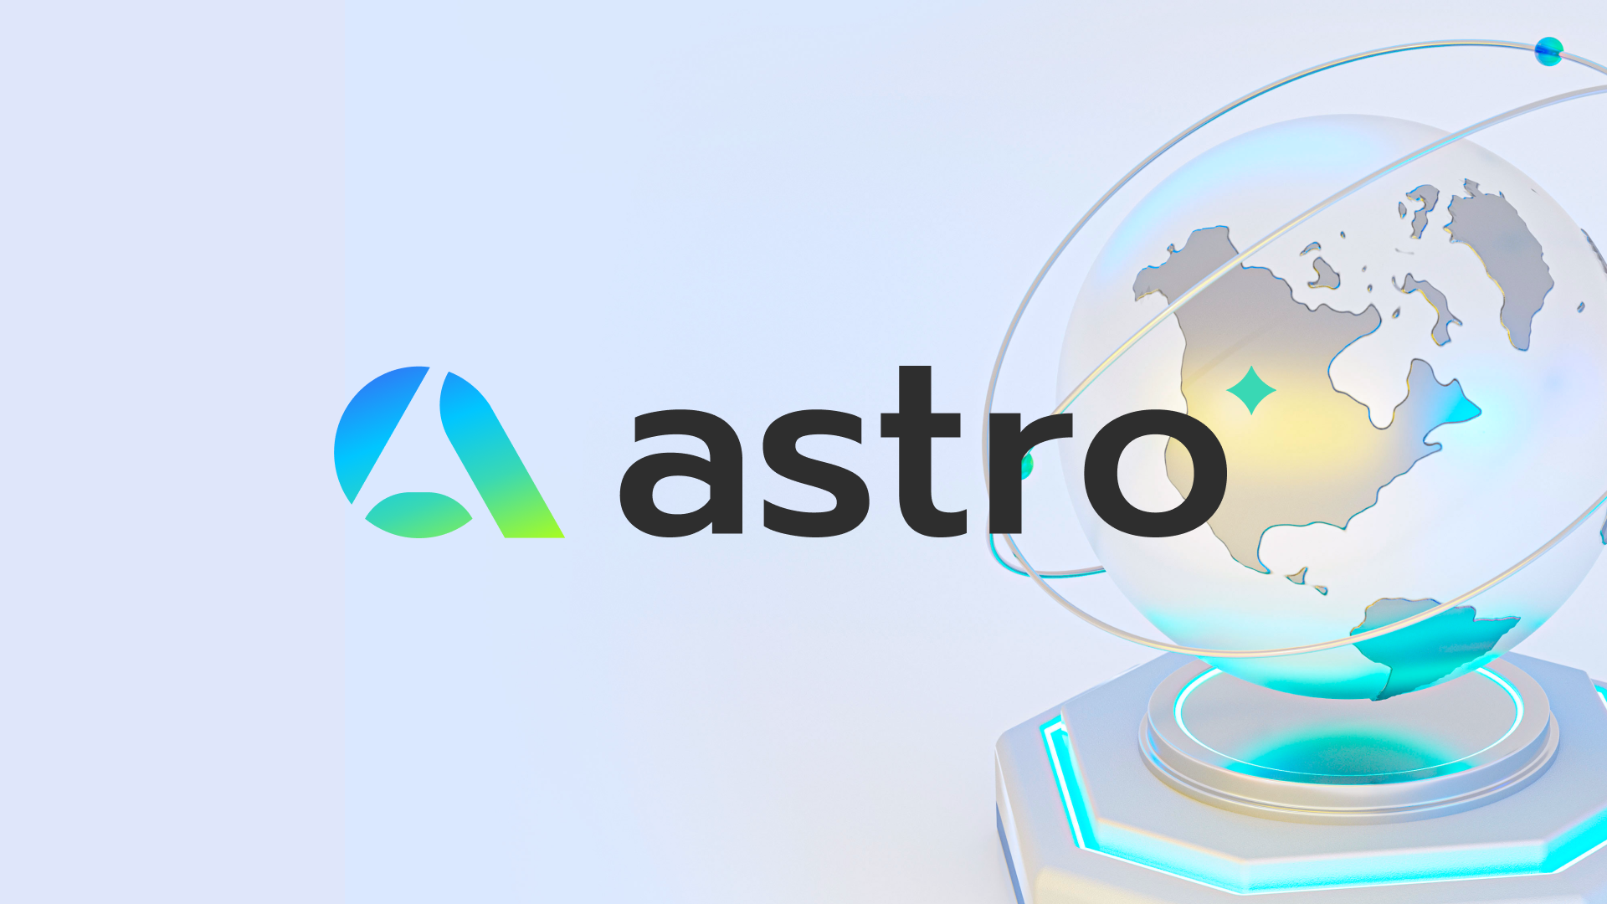


Astro Operates IPs with High Trust Score Only, Since They Ensure:
1
2
3
Enhanced Access
Improved Data Quality
Effortless Integration
No to IP flagging, Yes to consistent access to target websites.
Obtaining of accurate and reliable data while maintaining consistent connections.
Seamless integration into existing systems and workflows.
Eric Schmidt
the former CEO of Google
Who has often discussed the intersection of technology, data, and privacy in interview. He noted:
"The ability to collect data from multiple sources and geographies is critical for understanding the world as it is. Geo-targeted proxies, in particular, allow businesses to access region-specific information, which can significantly improve decision-making, localization, and market strategy."
The Power of
Geo-Targeted Proxies for
Web Data Collection
What is Trust Score?
Impact on Web Data Collection
The Trust Score of an IP address reflects its reliability in the eyes of websites and online services. A high Trust Score indicates a trustworthy IP with a clean history, while a low Trust Score raises red flags and may lead to blocked access. Websites like Google and Facebook often restrict access from IPs with low Trust Scores.
Websites can utilize sophisticated detection systems to identify and block requests coming from proxy servers with low Trust Scores. This presents a challenge for web data collection, as inaccurate data can result from blocked access or skewed results. Choosing proxies with high Trust Scores is essential for reliable data collection.

Slide 14




Enterprise-Level Proxy Infrastructure
Astro's Key Features
Astro provides a comprehensive proxy infrastructure designed for businesses and developers engaged in web data collection. It offers ethical sourcing of IP addresses, adherence to AML/KYC compliance standards, and compatibility with various third-party tools.
Compatibility with Third-Party Software
Astro smartly integrates with a wide range of third-party software, including popular antidetect browsers, headless browsers, and automated tools based on programming languages like Java, Python, and C#.
Overcoming WebRTC Issues
Astro offers solutions to WebRTC challenges, enabling you to maintain privacy. This includes using antidetect browsers, disabling WebRTC, and configuring settings for enhanced security.
Optimizing Your Selection & Configuration
Residential Proxies
Mobile Proxies
Datacenter Proxies
Residential proxies offer a high degree of privacy and are recommended for data collection and social media tasks. They're often preferred for their ability to mimic real user behavior. Astro suggests selecting residential proxies with city-level targeting for enhanced accuracy.
Mobile proxies provide a realistic mobile device experience and are particularly beneficial for tasks involving social media accounts. They can be grouped by city and mobile carrier for precise targeting and better mimic real user behavior.
Datacenter proxies offer fast connection speeds, they guarantee stable sessions with adjustable duration. These are pre-selected IP addresses that you can target by state, city, or ASN. They are best for data scraping with zero website restrictions.
Leveraging Proxies for Social Media Management
Facebook Accounts
X/Twitter Accounts
Instagram Accounts
For effective Facebook account management, Astro recommends using residential proxies grouped by city and mobile proxies grouped by city and carrier. Using a separate port for each account is crucial for maintaining privacy and security. Additionally, use the link option to maintain an external IP address while the account is active.
Similar to Facebook, X/Twitter account management often requires the use of geo-targeted proxies. Astro suggests a similar approach, using residential proxies with separate ports for each account and city-level targeting. Use the link option to maintain an external IP address.
For Instagram account management, Astro recommends employing residential proxies grouped by city with separate ports for each account. The link option can be used to maintain an external IP address. Mobile proxies grouped by city and carrier can also be employed.

Slide 15






Essential Steps for Successful Social Media Campaigns
1
Account "Warm-Up"
Before launching an advertising campaign, Astro recommends "warming up" your account. Increase the number of friends, join communities, like posts, and leave comments. Ensure that your activity, language, and location are consistent with the proxy's geolocation for a natural profile.
2
Traffic Package
For better performance, order a traffic package that supports your campaign's intensity. Astro recommends 500 MB per port or account with a change mode by the link. Assign a separate port for each account and ensure that the city and port match the account's location.
3
Long-Term Advertising
For long-term campaigns, Astro recommends adding multiple administrators to the page to prevent account suspension or access limitations. This provides redundancy and helps avoid potential issues.
Navigating Data Access Restrictions
Limited Access
Some websites may impose data access restrictions due to their security systems. You may encounter limitations based on your IP address, location, or other factors.
Seeking Support
If you encounter restrictions, Astro recommends contacting their Support Service for individual access requests. These requests are processed on a case-by-case basis and require agreement with the terms and conditions.
Whoer: IP Address Blacklist Checker
Whoer is a valuable tool for checking if your IP address is blacklisted. It can help determine if any limitations are due to a blacklist.
Astro's Expertise in Open Web Data Extraction
Data Quality
Astro prioritizes data quality and ensures that the proxies used for data collection meet high standards.
Data Extraction
Astro offers comprehensive solutions for internet data extraction, covering a range of applications.
Geo-Targeted IPs
Astro's expertise extends to geo-targeted proxies, providing tailored solutions for specific needs.
Use Cases
Astro's proxies are suitable for SEO, SMM, e-commerce, software testing, AI models, marketing, advertising, etc.
Gary Vaynerchuk
a prominent entrepreneur and social media strategist
In his book "Jab, Jab, Jab, Right Hook: How to Tell Your Story in a Noisy Social World", he emphasizes:
“Social media empowers voices while demanding precise audience targeting. Proxy services enable marketers to scale campaigns globally, unlocking crucial localized insights and opportunities.”

Slide 16



Astro: Safe Data Gathering
Dedicated to ethical and secure web data collection, the Astro infrastructure comes with a range of tools and services designed to help you gather valuable insights from the web.
KYC and AML Compliance
Know Your Customer
Anti-Money Laundering
At Astro, we prioritize user safety and transparency. To ensure the ethical use of our services, we require all users to undergo a Know Your Customer (KYC) verification process.
We comply with strict Anti-Money Laundering (AML) guidelines, ensuring that our platform is not used for illicit activities. This commitment helps protect both our users, partners, and the broader online ecosystem.
Real Peer-to-Peer Proxies
Our proxy domain consists of real, whitelisted IP addresses sourced from a global network of trusted individuals. This ensures the integrity and reliability of your data collection efforts.
Protecting User Privacy
We understand the importance of user privacy and data confidentiality. We do not share user information or proxy data with third parties, except when required by law.
AI-Powered Monitoring
Astro utilizes advanced AI algorithms to continuously monitor user activity and connections. This helps detect potential violations of our License Agreement and ensures the ethical use of our services.
Legal Transparency
We adhere to legally stipulated procedures when responding to law enforcement requests for proxy data. Our commitment to transparency and legal compliance fosters a secure and trustworthy environment for all users.
In an interview discussing the challenges of compliance in the digital finance world, Larsen said,
Chris Larsen
the co-founder of Ripple
"As global financial systems become more interconnected, the need for robust KYC and AML practices has never been more critical. Proxies are a necessary tool in this context, as they help businesses navigate jurisdictional challenges, enabling them to comply with local regulations while mitigating the risks of fraud and financial crime."
Larsen’s quote emphasizes the role that proxies can play in ensuring compliance with KYC and AML requirements. By using proxies, businesses can effectively manage geo-specific regulatory hurdles and enhance their ability to prevent financial crimes while maintaining customer privacy and trust.

Slide 17

Trusted and Verified
As a fully KYC and AML compliant platform, Astro requires all users to provide a valid ID for access to all features and account balance. This helps create a secure ecosystem for all participants.
Legal Transparency
We adhere to legally stipulated procedures when responding to law enforcement requests for proxy data. Astro treats KYC and AML issues as priorities. By this we mean logging all traffic according to KYC and AML, and fighting against abuse of any kind.
Start Gathering Data Securely
Astro empowers you to confidently and securely gather valuable web data. By joining our platform you can start leveraging the supreme tools for gaining insights and driving your business forward.
Astro's Support Team: Your Reliable Ally
Expert Assistance
Prompt Solutions
Our team is comprised of seasoned professionals, ready to tackle any challenge you may encounter. We are here to help you navigate through possible issues effortlessly.
We aim to provide solutions within 15 minutes during our working hours. While response times may vary based on workload, we'll deliver the support you need.
Building Trust: Your Success is Our Success
1
Transparent
We believe in transparency and clarity, keeping you informed about our services and any potential challenges you might face.
2
Reliable
Our team is committed to providing consistent support, ensuring that you can always count on us.
Trustworthy
3
We build trust through our commitment to excellence and by providing the support you need to achieve your web scraping goals.

Slide 18



Availability: Your Convenience is Our Priority
Our support team is available every day, so that you always have access to the help you need, no matter where you are in the world.
Facebook
Connect with us on Facebook to get quick answers and engage with our community.
Telegram
Join our Telegram group for real-time support, updates, and discussions with other Astro users.
Focus: Proxy Settings and Performance
Proxy Configuration
We'll guide you through setting up your proxy correctly, helping you have a seamless connection and smooth proxy usage experience.
Performance Optimization
We help you optimize your proxy settings for maximum speed and efficiency, allowing you to extract data quickly and effectively.
Troubleshooting
If you face any challenges, our team is ready to troubleshoot issues and provide solutions to ensure that your web sessions run uninterrupted.
Dedicated Support: Personalized Assistance
1
Personalized Approach
We understand that each user has unique needs. Our approach focuses on giving tailored
solutions that are right for you.
Dedicated Support
2
You'll be assigned a dedicated support representative who will guide you through any queries or issues you may have.
Collaborative Solutions
3
We work with you to understand your goals and challenges, striving for win-win with the most effective decisions for your web data projects.

Slide 19






As we have stepped into 2025, we eagerly anticipate further growth through expanded partnerships and making an even more significant global impact. Public web data serves as the cornerstone of today's digital landscape, and we remain steadfast in our commitment to ensuring its accessibility where it counts—driving market competition, enhancing public welfare, advancing vital research, all for the betterment of society. We consider this our responsibility.
Feel free to get in touch with Astro team.
Support
Via telegram
Via instagram
Via whatsapp
support@astroproxy.com
Via facebook
Join Astro's Community
Our telegram
Our facebook

